Slide 1
Today
Novel’s gambit, that pre-plague life is little different than post-plague life
  Mark Spitz mediocrity
  Straggler
    Whitehead innovation
    Small stories of city—Whitehead seems attracted to these—linked to Spitz seeing humanity in the skels
Other gambit: regulations, boredom (and later, racism) are what comes back first after the plague.
  Systematic salvage sought by Buffalo—reclaiming New York
  Regulations/order
Briefly

Slide 2
Whitehead and “genre” fiction
Wide range of contemporary “serious” writers take up genre fiction
Jonathen Lethem Fortress of Solitude
Michael Chabon, The Amazing Adventures of Kavalier & Clay
Junot Diaz The Brief Wondrous Life Oscar Wao
Jennifer Egan A Visit from the Goon Squad
Writers who grew up with comics, B movies on videocassette, widely available popular music.
We’ll talk more about how Whitehead “salvages” the zombie genre, but it’s worth knowing that Whitehead is part of a trend.

Slide 3
Thin Line between pre- and post- apocalyptic
Whitehead on novel:
“[E]arly on I decided that living in the end times in a ruined world is pretty much like living before, it’s just that 95% of the population is dead and people are more bummed out. When the characters in the book try to reestablish society they are still stuck in their old grooves. And I think the worst parts of contemporary society will come back quickly. So for me that is marketing, our need for fresh organic greens. It’s corporate branding, a need for catchy slogans” (Interview in Tin House)
Critic Mitchum Huehls:
"Whitehead makes it pretty clear that the zombie plague represents, or even allegorizes, the brain-dead homogenization wrought by contemporary capital: turns out we were always already zombies before the plague even began."

Slide 4
Thin Line between pre- and post- apocalyptic:
In what ways does this passage about the past (pre-plague) use language applicable to the novel’s zombie-filled present?
Take 1-2 minutes and jot down whatever comes to mind.
He liked to watch monster movies and the city churning below. He fixed on odd details. The ancient water towers lurking atop obstinate old prewars and, higher up, the massive central-air units that hunkered and coiled on the striving high-rises, glistening like extruded guts. The tar-paper pates of tenements. He spotted the occasional out-of-season beach chair jackknifed on gravel, seemingly gusted up from the street below. Who was its owner? This person staked out corners of the city and made a domain. He squinted at the slogans cantering along stairwell entrances, the Day-Glo threats and pidgin manifestos, a.k.a.'s of impotent revolutionaries. Blinds and curtains were open, half open, shut, voids in a punch card decipherable only by defunct mainframes lodged in the crust of unmarked landfills. Pieces of citizens were on display in the windows, arranged by a curator with a taste for non sequitur: the splayed pinstriped legs of an urban golfer putting into a colander; half a lady's torso, wrapped in a turquoise blazer, as glimpsed through a trapezoid; a fist trembling on a titanium desk. A shadow bobbed behind a bathroom's bumpy glass, steam slithering through the slit (5).

Slide 5
World before the plague
First two rows, right half of room: “The only downer was the ogre-head of Human Resources […] everything escaped (20-21)
Second two rows, left half of room: “When using the word “dead,” most survivors signaled to the listener[…] extinguished world that they were doomed in this new one” (31).
First two rows, left half of room: “After four flights, Mark Spitz had the complex’s blueprints in his pocket,. […] an identical distance from the flat-screen television. They had been a community” (71).
Second two rows, left half of room: “One of those seekers powerless […] At least that part of the program was true to life, he thought (72-73).
For your passage: what adjectives would you use to describe life as depicted here? (such as “routine,” “mechanized,” “repetitive,” and so on)

Slide 6
Where do you see parallels between the list of adjectives on the board and this passage about skels?
The dead could turn a doorknob, hit a light switch-the plague didn’t erase muscle memory. Cognition was out, though, once it overwrote the data of self. These creatures had been stymied for years by the broken lock. Bumping into each other and ricocheting around the desk and chairs and cabinets, losing wigs, rings, and watches as they grew more and more emaciated. Pratfalling over their accessories and then rising again like the mechanical entities they had become (34).

Slide 7
Mark Spitz mediocrity
What adjectives would you apply to Mark Spitz?
Right half of the room: “He'd never had trouble with the American checklist[…] It was his solemn expertise” (11).
Left half of the room: He still had a soft spot for Miss Alcott, all these years later, for it had been in her English class that he realized he was utterly unremarkable[…] He hovered on unexceptionality (69).

Slide 8
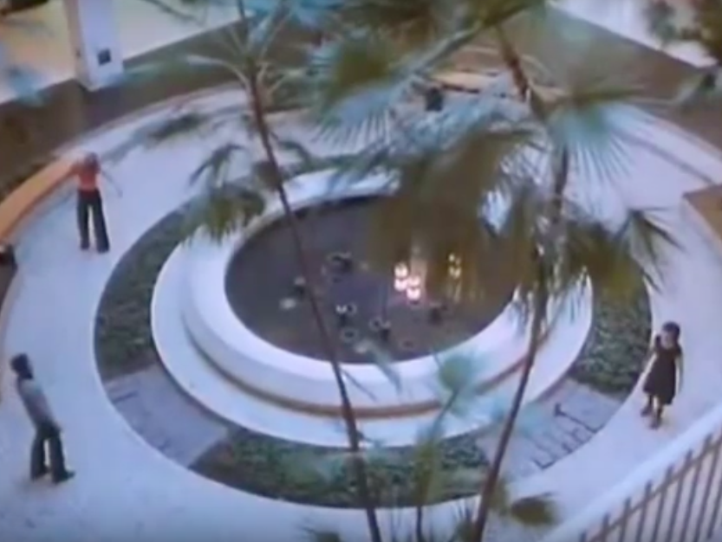
Whitehead—drew inspiration from Dawn of the Dead (1969) shopping mall scene
https://youtu.be/7zK_44APmbY

Slide 9
Stragglers—how would you describe these?
The stragglers[…] were a succession of imponderable tableaux, the malfunctioning stragglers and the places they chose to haunt throughout the Zone and beyond. An army of mannequins, limbs adjusted by an inscrutable hand. The former shrink, plague-blind, sat in her requisite lounge chair, feet up on the ottoman, blank attentive face waiting for the patient who was late, ever late, and unpacking the reasons for this would consume a large portion of a session that would never occur. The patient failed to arrive, was quite tardy, was dead, was running through a swamp with a hatchet, pursued by monsters. The pock-faced assistant manager of the shoe store crouched before the foot-measuring instrument, frozen, sans customers, the left shoes of his bountiful stock on display along the walls of the shop on miniature plastic ledges. The vitamin-store clerk stalled out among the aisles, depleted among the plenty, the tiny bottles containing gel-capped ancient remedies and placebos. The owner of the plant store dipped her fingers into the soil of a pot earmarked for a city plant, one hearty in the way the shop’s customers were hearty, for wasn’t every citizen on the grand island a sort of sturdy indoor variety that didn’t need much sunlight. A man wrapped in the colors of the Jamaican flag loitered over the new bongs, the creme de la creme of head-shop apparatus, rainbow bulbs perforated according to the latest notions about air circulation, intake, draw. No smoke, no fire. In the desolate consumer-electronics showroom, the up-selling floor salesman halted mid-pitch, as if psychoanalyzing a skeptical rube who was simply, ever and always, not in the room, not in the market for purchases big-ticket or otherwise. A man bent before a mirror that perched on the glass counter of a sunglasses store, his fingers holding on the arms of invisible shades. A woman cradled a wedding dress in the dressing room’s murk, reenacting without end a primal moment of expectation. A man lifted the hood of a copy machine. They did not move when you happened on them. They didn’t know you were there. They kept watching their movies (60).

Slide 10

But if everything seems dead, Mark Spitz still wants to find something worth salvaging:
“It happened every so often […] he was on the carpet.” (19).
“The indicators […] the next moment he was weeping, fingers curled into a nautilus across his face and snot seeping into his mouth, sweetly” (78-79).

Slide 11
Buffalo as site of control
Critic Leif Sorenson—inclusion Buffalo narrative turns individual stories of survival into larger story of “national” transition
Demands that every individual develop a relationship with Buffalo, instead of pursuing their own individual struggles (as things were in the “interregnum” or as they are in other post-apocalyptic stories)

Slide 12
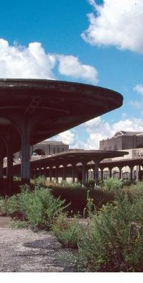
What, then, characterizes Buffalo?
  “the regulations, No-No card” (21)
  “sponsor cigarettes” (30)
  “The info-gathering directives…” (34)
  “Buffalo, he explained, wanted information on the general outline of each engagement” (37)
  Account of armadillo brand (38)
  Long description Buffalo (43)
  Juggernaut clothing empire (46-47)

Slide 13
Child as Symbol Future
Lee Edelmen in No Future—argues that much of contemporary culture revolves around reproduction & the child.
Why do you think Whitehead includes the Tromanhauser Triplets (49-51)?

Slide 14
What can be salvaged
For all that had transpired outside this building in the great unraveling, the pure industry of this place still persisted. Insisting on itself. He felt it in his skin even though the people were gone and all the soft stuff was dead. Moldering lumps shot out tendrils in the common-area fridges, and the vicinities of the dry water-coolers were devoid of shit-shooting idlers, but the ferns and yuccas were still green because they were plastic, the awards and citations remained secure on the walls, and the portraits of the bigwigs preserved one afternoon's calculated poses. These things remained (14).

Slide 15
“In the days following his arrival in the Zone, he'd mulled over the Lieutenant's theory of the barricades. Yes, they were the only vessel strong enough to contain our faith. But then there are the personal barricades, Mark Spitz thought. Since the first person met the second person. The ones that keep other people out and our madness in so we can continue to live. That's the way we've always done it. It's what this country was built on. The plague merely made it more literal, spelled it out in case you didn't get it before. How were we to get through the day without our barricades? But look at him now, he thought. They were his family, Kaitlyn and Gary, and he was theirs. He owned nothing else besides them, and the features of his dead that he superimposed on the faces of the skels, those shoddy rubber masks he pulled out of his pockets. He knew it was pathetic to carry them with him, a lethal sentimentality, but it warded off the forbidden thought. The faces of his dead were part of his barricade, stuck on pikes atop the length of the concrete” (127).

Slide 16
Spitz attention to skels
“The skel wore a morose and deeply stained pinstripe suit, with a solid crimson tie and dark brown ta.s.seled loafers. A casualty, Mark Spitz thought. It was no longer a skel, but a version of something that predated the anguishes. Now it was one of those laid-off or ruined businessmen who pretend to go to the office for the family's sake, spending all day on a park bench with missing slats to feed the pigeons bagel bits, his briefcase full of empty potato-chip bags and flyers for ma.s.sage parlors. The city had long carried its own plague. Its infection had converted this creature into a member of its bygone loser cadre, into another one of the broke and the deluded, the mis-fitting, the inveterate unlucky. They tottered out of single-room occupancies or peeled themselves off the depleted relative's pullout couch and stumbled into the sunlight for miserable adventures. He had seen them slowly make their way up the sidewalks in their woe, nurse an over-creamed cup of coffee at the corner greasy spoon in between health department crackdowns. This creature before them was the man on the bus no one sat next to, the haggard mystic screeching verdicts on the crowded subway car, the thing the new arrivals swore they'd never become but of course some of them did. It was a matter of percentages” (148-9)

Slide 17
Gaston Bachelard, The Poetics of Space
All really inhabited space bears the essence of the notion of home (5)
“Without [the house] man would be a dispersed being. It maintains him through the storms of the heavens and through those of his life” (7)
Comfort itself with the illusion of protection—or, just the contrary, tremble behind thick walls, mistrust the staunchest ramparts” (5)
“Through dreams, the various dwelling-places in our lives co-penetrate and retain the treasures of former days” (5)
The house shelters daydreaming, allows one to dream in peace (7)
Argument—places in which we experience daydreaming reconstitute selves in new daydream “and it is because our memories of former dwelling-places are relived as daydreams that these dwelling-places of the past remain in us for all times” (6)
Topoanalysis—localization of memories for psychoanalysis (8)
“In the past, the attic may have seemed too small, it may have seemed cold in winter and hot in summer. Now, however, in memory recaptured through daydreams, it is hard to say through what syncretism the attic is at once small and larger, warm and cool, always comforting” (10).

