Slide 1
Today: Sophocles’s Antigone
Quiz
Creon and power (continued)
Antigone response to Creon
Haemon argument with Creon
Sample response question (first response will be in-class next Friday)

Slide 2
Creon and power
Read 21-25
  What has happened?
  How does Creon treat the guard?
  What does this say about how he views power?

Slide 3
For discussion in small groups
Page 19, 23
How would you characterize Creon’s point of view? List some words that seem important to Creon.
Why do you think Creon issues the decree (declares Polyneices to be inhuman)?
  You can list more than one reason

Slide 4
Why make Antigone Haemon’s fiancée?
Makes Creon seem all the more foolish
Harmon = speaks for Thebes, show viewpoint public
Also—lets us see limitations of patriarchal succession

Slide 5
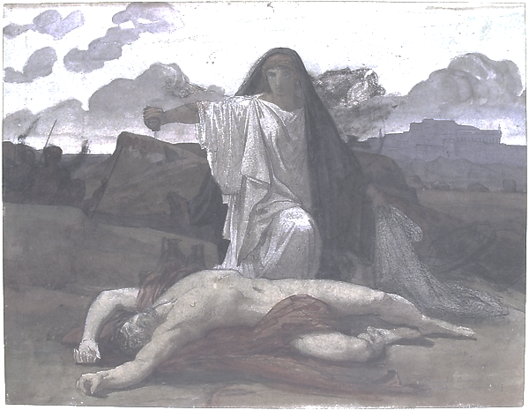
Haemon
First, what does Creon ask of Haemon on page 37?
Next, read Haemon’s argument and summarize it (39)

Slide 6
Antigone’s Critique of Power 29-32
Choose one of the following arguments and pick passages that support it. Once you pick the passage, write a sentence or two explaining how the passage supports your idea:
The gods’ laws matter more than human laws
Loyalty to family is more important than loyalty to state

Slide 7
Haemon lines 720-729 (page 39)
But, for a man to learn, even a wise man,
is nothing shameful, nor to learn to bend and give way. You see how, in the winter
storms, the trees yield that save even their twigs
but those who oppose it are destroyed root and branch
Just so the captain who never slackens
his sail once he’s stretched it gets his boat turned
and sails the rest with benches upside down
Rather, yield your anger and let yourself change

Slide 8
Antigone and family
In her speeches before she is entombed, Antigone reminds us of what’s at stake with her burial, in terms of her humanity and that of her brother.
  Find places where Antigone reminds us of what’s at stake with Polynecies (his humanity).
  Find places where Antigone reminds us of why the simple qualities of being human are important.
Left side
43-45
Right side
46-47

Slide 9
Sample response question
Please answer the following question in 5 minutes, using as much detail from the text as you can.
How does Antigone’s viewpoint differ from Creon’s viewpoint?

