Slide 1

Today: Sophocles’s Antigone
Announcement of syllabus change.
Summary of what we have learned so far.
Antigone’s claim for the human.
Haemon’s argument with Creon.
Tiresias's argument against Creon.
Sample response question
Evaluating Creon as a leader.

Slide 2
Syllabus change
Response #1 will now be on Monday, January 27
On Friday and the first half of Monday, we will continue discussing Antigone.
We will begin discussing Shakespeare’s The Tempest on Wednesday, January 29.
Full changes will be posted to the syllabus by the end of today. (These are already there for this week and next week.)

Slide 3
So far, we have learned
That Creon has issued a decree banning the burial of Polyneices, and demands absolute obedience to his laws.
That Antigone has defied this decree
That Ismene initially opposed Antigone’s action, but later sides with Antigone
That Antigone has made claims for the humanity of both Polyneices and herself.
That Creon had Antigone buried alive
That Haemon, Creon’s son, questioned this action and suggested that the people are opposed to Creon’s decisions.

Slide 4
What potential problems do you see resulting from these relationships?
Creon | Speaks for:
State
Order
Laws must be obeyed
Polyneices = enemy = inhuman
Uncle
Future father in law
Gods
Morality
Father
Antigone | Speaks for
Kin (Family)
Unjust laws can be broken
Polyneices = brother = human
Haemon | Speaks for
Antigone
People of Thebes
Polyneices = Antigone’s brother = human
Tiresias | Speaks for
Gods
Polyneices = human, because humans shouldn’t be left unburied
Law forbidding burial unjust
Fiancée
Enemy
Sister
Brother
Ismene | Speaks for
Antigone
Kin (weaker than Antigone)
Laws must be followed (changes as play progresses)
Polyneices
Antigone’s brother
Has been declared enemy = inhuman
Brother

Slide 5
Antigone’s Critique of Power 29-32
Skim through pages 29-32.
Choose one of the following arguments and pick a passage that supports it. Once you pick the passage, write a sentence or two explaining how the passage supports your idea:
The gods’ laws matter more than human laws
Loyalty to family is more important than loyalty to state

Slide 6
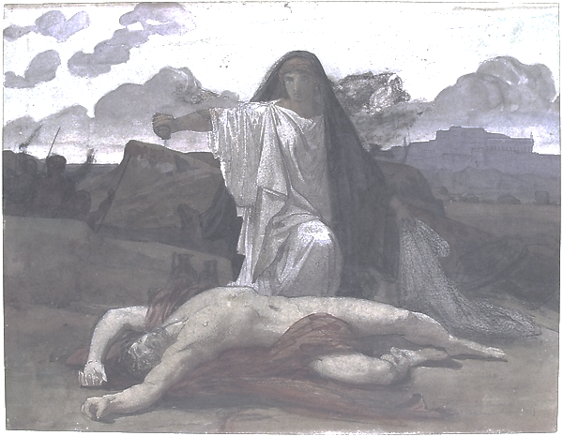
Haemon (Creon’s son, Antigone’s fiancée)
First, what does Creon ask of Haemon on page 37?
Next, read Haemon’s argument and summarize it (39).

Slide 7
Haemon lines 720-729 (page 39)
But, for a man to learn, even a wise man,
is nothing shameful, nor to learn to bend and give way. You see how, in the winter
storms, the trees yield that save even their twigs
but those who oppose it are destroyed root and branch
Just so the captain who never slackens
his sail once he’s stretched it gets his boat turned
and sails the rest with benches upside down
Rather, yield your anger and let yourself change
How would you summarize this argument? How does it contrast with what Creon believes about power?

Slide 8
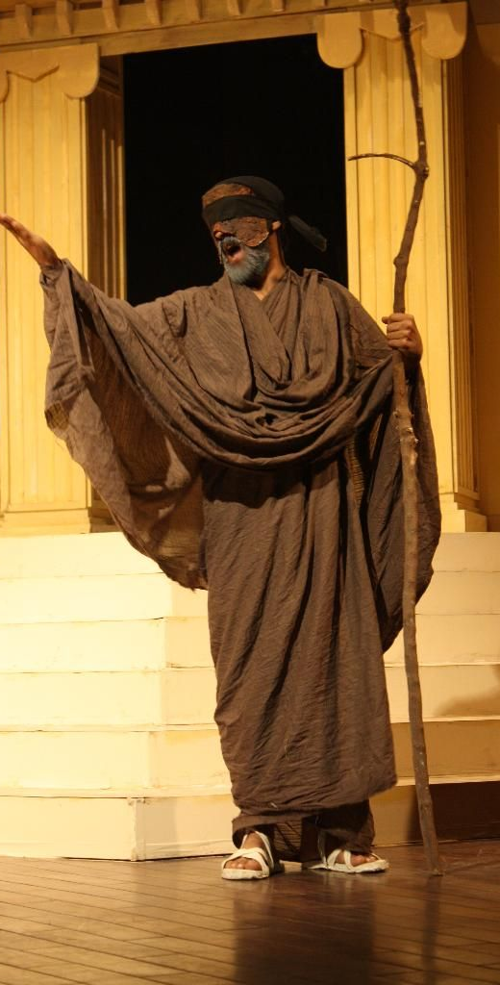
Teiresias
Representative of the gods—speaks with authority—but often speaks cryptically
Neutral party—not a citizen of Thebes, nor member of the family
Advisor to Creon who has been trusted in the past
  Read your assigned lines, and pick out a line or two that seem significant in these terms. Why do you think this line is important?

Slide 9
Why Tiresias
Creon has not changed his mind after hearing his son’s opinion, nor that of the city.
Watch the following clip.
As you watch, think about: what is it about Tiresias that causes Creon to change his mind?
Creon and Tiresias argument:
https://www.youtube.com/watch?v=Dwr-PqGpY38

Slide 10
Sample response question
Working in pairs, please answer the following question in 5 minutes, using as much detail from the text as you can.
How does Antigone’s viewpoint differ from Creon’s viewpoint?

Slide 11
Resolving Creon
Speech messenger bottom 55-56
Creon dialog page 59-62
Leaders need to make good judgments.
How has Creon made bad judgments about the following categories?
  Traitor
  Human

