Slide 1
Today: “The Haunter of the Dark”
Reading assessment #1
Problem of darkness
Blake’s attraction to horror
Why the church?
Weird books in a weird book.
Storm and weird

Slide 2
Simple problem of darkness
What do we make of the simple problem of losing electric power?
He upbraids himself for not doing something, and speculates wildly on the consequences of another electrical breakdown. It has been verified that on three occasions—during thunderstorms—he telephoned the electric light company in a frantic vein and asked that desperate precautions against a lapse of power be taken (355).

Slide 3
What attracts Blake to Federal Hill?
Blake had a curious sense that he was looking upon some unknown, ethereal world which might or might not vanish in dream if ever he tried to seek it out and enter it in person (338)
“that shimmering, spire-crowned mound in the distance whose unknown streets and labyrinthine gables so potently provoked his fancy. From his few local acquaintances he learned that the far-off slope was a vast Italian quarter, though most of the houses were remnants of older Yankee and Irish days” (338).
“More and more he would sit at his westward window and gaze at the distant hill and the black, frowning steeple shunned by the birds. When the delicate leaves came out on the garden boughs the world was filled with a new beauty, but Blake’s restlessness was merely increased. It was then that he first thought of crossing the city and climbing bodily up that fabulous slope into the smoke-wreathed world of dream (339-340)
Blake knew at once what it was, and plunged toward it through the squalid, unpaved lanes that climbed from the avenue. Twice he lost his way, but he somehow dared not ask any of the patriarchs or housewives who sat on their doorsteps, or any of the children who shouted and played in the mud of the shadowy lanes” (340)

Slide 4
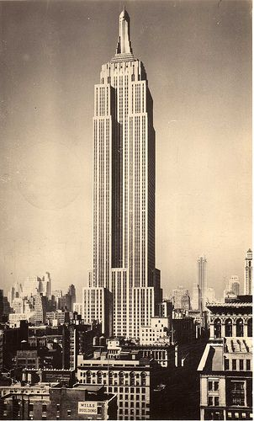
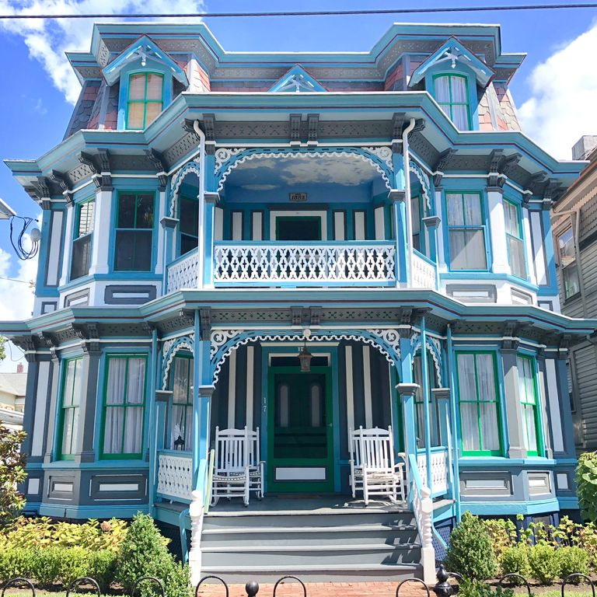
Lovecraft and historic buildings
In a letter dated 1926, he wrote, “My life lies not among people but among scenes—my local affections are not personal, but topographical and architectural” (Lovecraft to Lillian Clark, 29 March 1926, Lovecraft Papers).
Believed in tradition as a stay against modern changes—industrialization, immigration, mass culture.
Worked to preserve historic buildings in Providence.
Hated modern architecture: felt that it had abandoned meaning in favor of pure function.

Slide 5
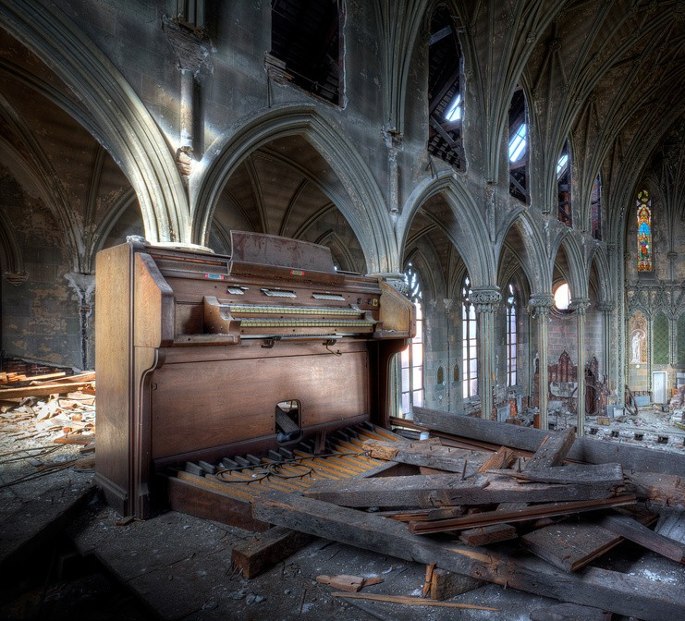
Why a church?
Look at the description of the church on pages 341, 343, 344.
Note any details that seem important.
What do churches “normally” represent?

Slide 6
Weird books.
What adjectives would you use to describe these books?
In a rear vestry room beside the apse Blake found a rotting desk and ceiling-high shelves of mildewed, disintegrating books. Here for the first time he received a positive shock of objective horror, for the titles of those books told him much. They were the black, forbidden things which most sane people have never even heard of, or have heard of only in furtive, timorous whispers; the banned and dreaded repositories of equivocal secrets and immemorial formulae which have trickled down the stream of time from the days of man’s youth, and the dim, fabulous days before man was. He had himself read many of them—a Latin version of the abhorred Necronomicon, the sinister Liber Ivonis, the infamous Cultes des Goules of Comte d’Erlette, the Unaussprechlichen Kulten of von Junzt, and old Ludvig Prinn’s hellish De Vermis Mysteriis. But there were others he had known merely by reputation or not at all—the Pnakotic Manuscripts, the Book of Dzyan, and a crumbling volume in wholly unidentifiable characters yet with certain symbols and diagrams shudderingly recognisable to the occult student. Clearly, the lingering local rumours had not lied. This place had once been the seat of an evil older than mankind and wider than the known universe (344).
More weird books (350).

Slide 7
How would you describe what Blake feels here? Where have we seen this before?
He felt entangled with something—something which was not in the stone, but which had looked through it at him—something which would ceaselessly follow him with a cognition that was not physical sight (349)
But his worst fears concerned himself, and the kind of unholy rapport he felt to exist between his mind and that lurking horror in the distant steeple—that monstrous thing of night which his rashness had called out of the ultimate black spaces. He seemed to feel a constant tugging at his will, and callers of that period remember how he would sit abstractedly at his desk and stare out of the west window at that far-off, spire-bristling mound beyond the swirling smoke of the city (353)

Slide 8
What does it mean (about Nature, perhaps) that Lovecraft uses an ordinary storm to convey cosmic horror?
The great storm broke just before midnight on August 8th. Lightning struck repeatedly in all parts of the city, and two remarkable fireballs were reported. The rain was torrential, while a constant fusillade of thunder brought sleeplessness to thousands. Blake was utterly frantic in his fear for the lighting system, and tried to telephone the company around 1 a.m., though by that time service had been temporarily cut off in the interest of safety. He recorded everything in his diary—the large, nervous, and often undecipherable hieroglyphs telling their own story of growing frenzy and despair, and of entries scrawled blindly in the dark (355).

