Slide 1
Weird, Day 1:
H.P. Lovecraft

Slide 2
H.P. Lovecraft 1890-1937
Career = marked by failure—published in cheap magazines (“pulps”) died penniless
Why are we reading him? (he has been widely read in the past decade, for a number of reasons)
Was he racist? (probably, yes, for sure)
What might be interesting about his writing?
  (Mostly, the content—the sense of a vast, indifferent, nonhuman world that underlies much of his work.)

Slide 3
Why Lovecraft, why now?
2005 Modern American Library edition authorized his inclusion in the canon.
Roleplaying games, films, cultural references have made him popular to a current generation of writers such as China Mieville and Jeff VanderMeer (sometimes called “New Weird” writers).
He has become of interest to a group of philosophers called object oriented ontologists.

Slide 4
Why Lovecraft, why now?
As the world has become more threatening (as we brew the storms but we cannot control them), Lovecraft’s world becomes recognizable.
Benjamin Loy: Lovecraft “literature that denies the centrality of human life within a rapidly expanding cosmos, where humans feel their smallness and insignificance in the face of larger and more powerful cosmic forces “

Slide 5
What kind of vast inhuman world?
Non-Euclidian geometry—mathematically proven in the 19th century.
If math no longer conforms to the world, that might mean that there is more to the world than human perception.
Old ones, Cthulhu, etc. are all supposed to be part of a world that is not part of this world.
This is one location of “the weird”—all that stuff that is off the page, but to which the stories allude.

Slide 6
He’s racist. Where do we go from here?
This is a good question. I’ve spent lots of time during the past month thinking about this. From what I can tell, these are some answers:
  It’s true that lots of people of his era believed in white supremacy.
  In his tales, the protagonists often become part of the very things they describe in racist terms.
  Lovecraft hated himself as much as he hated different types of humans.
  Because he’s overt about his racial feelings, we can perhaps see how some racial imaginaries underlie horror.
  Michel Houellebecq: HPL reduced racism to its basest form: fear

Slide 7
Great Gatsby
F. Scott Fitzgerald—also part of white supremacist formation
Shadow Over Innsmouth
Protagonist/narrator racist
Lovecraft overtly racist
Protagonist becomes that which he initially fears
Potentially, then, by paying attention to Lovecraft we learn something about whiteness, especially whiteness in its weaker, more tenuous forms (Lovecraft never felt himself to be a success)
Racism located with Tom Buchanan—marginal part of story, villain

Slide 8
But also, this

Slide 9
“The Outsider” Weird Tales 1926
Skim through the story. Write down everything you remember about its protagonist.
Left half of room: 43-45
Right half of room: 45-49

Slide 10
“The Outsider” Weird Tales 1926
some critics say this is about Lovecraft himself, e.g. these quotations:
“I have no illusions concerning the precarious status of my tales, and do not expect to become a serious competitor of my favorite weird authors.”
"No one is more acutely conscious than I of the inadequacy of my work... I am a self-confessed amateur and bungler, and have not much hope of improvement"
Michel Houellbecq: “[HCL] knew perfectly well that there was no part for him in any heroic Valhalla of battles and conquests other than that of the vanquished, as usual. He was pierced to the core by his failures, by what seemed like his wholly natural and fundamental predisposition to failure. And in his literary universe, there could only be one part for him: that of the victim” (109).

Slide 11
Weird reading
Actual words on page
Realm of Weird

Slide 12
Weird reading
I cannot even hint what it was like, for it was a compound of all that is unclean, uncanny, unwelcome, abnormal, and detestable. It was the ghoulish shade of decay, antiquity, and desolation; the putrid, dripping eidolon of unwholesome revelation; the awful baring of that which the merciful earth should always hide. God knows it was not of this world—or no longer of this world—yet to my horror I saw in its eaten-away and bone-revealing outlines a leering, abhorrent travesty on the human shape; and in its mouldy, disintegrating apparel an unspeakable quality that chilled me even more (48).
Realm of Weird

Slide 13
Defamiliarization
Most daemoniacal of all shocks is that of the abysmally unexpected and grotesquely unbelievable. Nothing I had before undergone could compare in terror with what I now saw; with the bizarre marvels that sight implied. The sight itself was as simple as it was stupefying, for it was merely this: instead of a dizzying prospect of treetops seen from a lofty eminence, there stretched around me on a level through the grating nothing less than the solid ground, decked and diversified by marble slabs and columns, and overshadowed by an ancient stone church, whose ruined spire gleamed spectrally in the moonlight (46).
Note how this passages causes readers to view a familiar thing—the ground—as something unfamiliar and new.

Slide 14
Sense of abjection:
Note the feelings of revulsion experienced by the narrator here.
What does it say that he has these feelings about himself?
As I did so I became suddenly and agonisingly aware of the nearness of the carrion thing, whose hideous hollow breathing I half fancied I could hear. Nearly mad, I found myself yet able to throw out a hand to ward off the foetid apparition which pressed so close; when in one cataclysmic second of cosmic nightmarishness and hellish accident my fingers touched the rotting outstretched paw of the monster beneath the golden arch (48).

Slide 15
Questions for each weird text:
Human-like creatures who are not human?
Use of nonlinguistic communication?
Artifacts exchanged between human and inhuman world?
Human difference (racial, gender, ability) used to interpret/explain nonhuman?
Human world depicted as one of illusion?
Sense of abjection?
Defamilarization used to disrupt reader’s experience human world?
Weird used to explain or trouble ordinary domestic relationships?

Slide 16
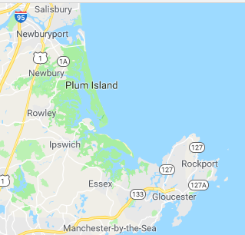
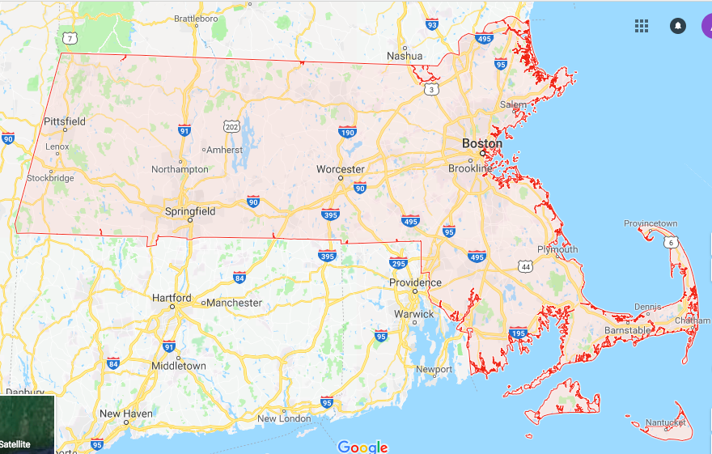
Innsbrouck
Innnsbrouk (thereabouts)
For your page, tell us everything you can about the town and/or its inhabitants
270-303
Providence, RI—HPL hometown

Slide 17
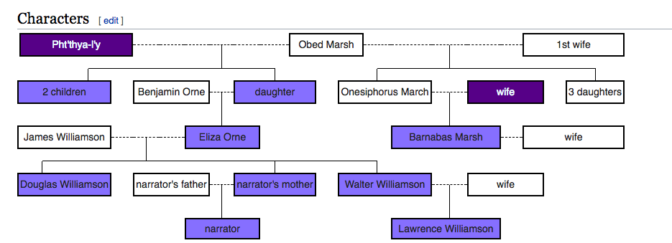
At the end of the story, we learn that Robert Olmstead is part of the very town he has been describing as fearful.

