Slide 1
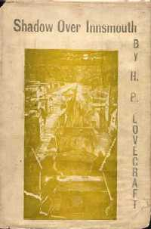
Shadow Over Innsmouth
Written in November–December 1931
Uses mix of detective and Gothic genres.
Part of Cthulhu Mythos (Old Ones
Originally rejected by Weird Tales
Only Lovecraft story to be published in book form during his lifetime (but only 400 were printed and 200 bound).

Slide 2
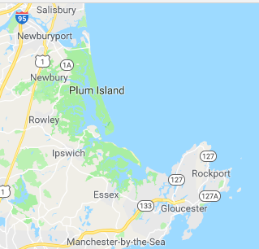
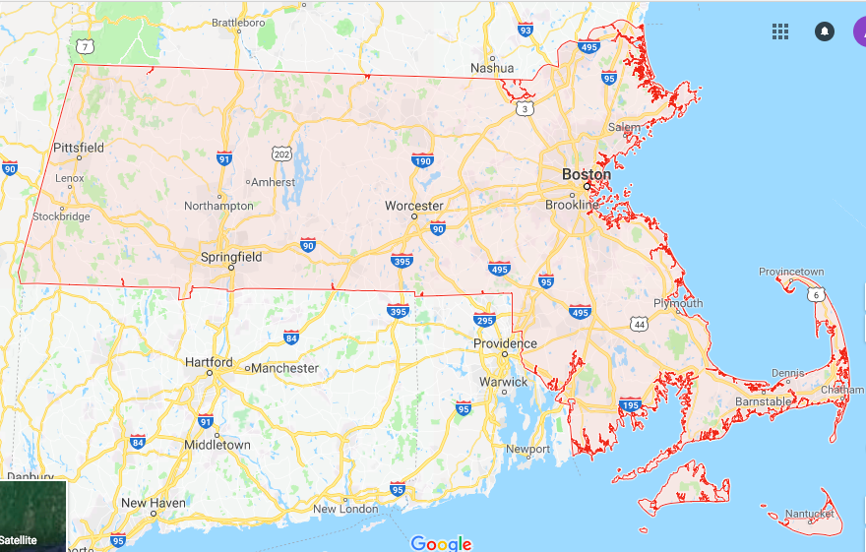
Innsmouth
Innsmouth (thereabouts)
Lovecraft often uses a framework of the “normal” to establish the weird—universities, scientists, government reports.
The account of the ticket-seller (270-274) serves as one such frame.
Skim the section. What are the ways that the ticket-seller establishes Innsmouth as abnormal?
Providence, RI—HPL hometown

Slide 3
What is weird about the tiara?
It took no excessive sensitiveness to beauty to make me literally gasp at the strange, unearthly splendour of the alien, opulent phantasy that rested there on a purple velvet cushion. Even now I can hardly describe what I saw, though it was clearly enough a sort of tiara, as the description had said. It was tall in front, and with a very large and curiously irregular periphery, as if designed for a head of almost freakishly elliptical outline. The material seemed to be predominantly gold, though a weird lighter lustrousness hinted at some strange alloy with an equally beautiful and scarcely identifiable metal. Its condition was almost perfect, and one could have spent hours in studying the striking and puzzlingly untraditional designs—some simply geometrical, and some plainly marine—chased or moulded in high relief on its surface with a craftsmanship of incredible skill and grace (276)

Slide 4
Descriptions of Innsmouth people.
What seems notable about the way Lovecraft describes the residents of Innsmouth, here or elsewhere?
“When the driver came out of the store I looked at him more carefully and tried to determine the source of my evil impression. He was a thin, stoop-shouldered man not much under six feet tall, dressed in shabby blue civilian clothes and wearing a frayed grey golf cap. His age was perhaps thirty-five, but the odd, deep creases in the sides of his neck made him seem older when one did not study his dull, expressionless face. He had a narrow head, bulging, watery blue eyes that seemed never to wink, a flat nose, a receding forehead and chin, and singularly undeveloped ears. His long, thick lip and coarse-pored, greyish cheeks seemed almost beardless except for some sparse yellow hairs that straggled and curled in irregular patches; and in places the surface seemed queerly irregular, as if peeling from some cutaneous disease. His hands were large and heavily veined, and had a very unusual greyish-blue tinge. The fingers were strikingly short in proportion to the rest of the structure, and seemed to have a tendency to curl closely into the huge palm. As he walked toward the bus I observed his peculiarly shambling gait and saw that his feet were inordinately immense. The more I studied them the more I wondered how he could buy any shoes to fit them” (279).
“As they reached the broad open space where I had had my first disquieting glimpse of the moonlit water I could see them plainly only a block away—and was horrified by the bestial abnormality of their faces and the dog-like sub-humanness of their crouching gait. One man moved in a positively simian way, with long arms frequently touching the ground; while another figure—robed and tiaraed—seemed to progress in an almost hopping fashion.” (323)

Slide 5
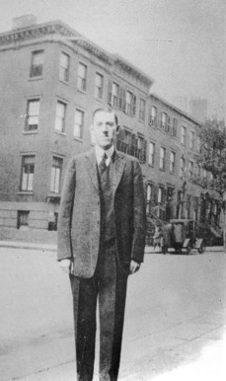
Lovecraft—lived in New York March 1924 to mid-April 192
”Disastrous” – could not find work
Wrote in letter immigrants "could not by any stretch ofthe imagination be call'd human." "monstrous and nebulous adumbrations of the pithecanthropoid and amoebal.
“[Philadelphia has] none of the crude, foreign hostility and underbreeding of New York — none of the vulgar trade spirit and plebian hustle.” He further described New York as “an Asiatic hell’s huddle of the world’s cowed, broken, inartistic, and unfit.”
Lovecraft views in keeping with early 20C eugenicist movement—propagate belief that some people (immigrants, people of color = ”inferior stock”
1924 Immigration Restriction Act--

Slide 6
Read the backstory provided by Zadok. List details that seem important.
(295-306)

Slide 7
Innsmouth as city slum
Why do you think Lovecraft uses the ordinary language of decaying slums to describe Innsmouth?
“Here and there the ruins of wharves jutted out from the shore to end in indeterminate rottenness, those farthest south seeming the most decayed.” (282)
“Collapsing huddles of gambrel roofs formed a jagged and fantastic skyline, above which rose the ghoulish, decapitated steeple of an ancient church. Some houses along Main Street were tenanted, but most were tightly boarded up. Down unpaved side streets I saw the black, gaping windows of deserted hovels, many of which leaned at perilous and incredible angles through the sinking of part of the foundations” (281)
“The tottering waterfront hovels north of the river were reputedly connected by hidden tunnels, being thus a veritable warren of unseen abnormalities” (287).
“The town, I could see, formed a significant and exaggerated example of communal decay; but being no sociologist I would limit my serious observations to the field of architecture” (289).

Slide 8
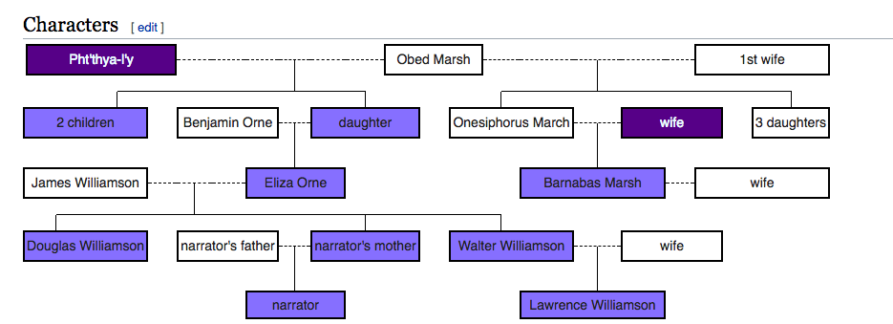
At the end of the story, we learn that Robert Olmstead is part of the very town he has been describing as fearful.

