Slide 1
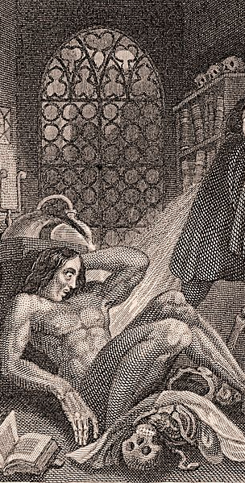
In order to get credit for today’s class, you need to complete the following work by Monday, February 17 at midnight. (Details for steps 2-4 appear in the slides.)
Read these slides.
Contribute to the Pilot discussion topic “What Could Victor Learn from Clerval?” and comment on at least one other student’s contribution.
Contribute to the Pilot discussion topic “Elizabeth as Contrast to Victor” and comment on at least one other student’s contribution.
Contribute to the Pilot discussion topic “Justine’s Treatment by the Crowd” and comment on at least one other student’s contribution.
Note: Do not feel like you have to overdo it on contributions. You can write as much as you like, but 1-3 sentences is a fine amount. Provided you have read the assigned pages first, work should take about 55 minutes (regular class time); if you find that it takes much longer, please let me know.

Slide 2
Both Henry Clerval and Elizabeth serve as counter-examples for Victor
Clerval, too, has dreams of glory:
“Meanwhile Clerval occupied himself, so to speak, with the moral relations of things. The busy stage of life, the virtues of heroes, and the actions of men, were his theme; and his hope and his dream was to become one among those whose names are recorded in story, as the gallant and adventurous benefactors of our species” (39).
But Clerval’s interests seem different than those of Victor: he goes to Ingolstadt to study languages (70) and had expressed interest in writing poetry.
And Clerval seems to be, well, less self-focused? More caring? than Victor:
“During all that time Henry was my only nurse. I afterwards learned that, knowing my father's advanced age, and unfitness for so long a journey, and how wretched my sickness would make Elizabeth, he spared them this grief by concealing the extent of my disorder. He knew that I could not have a more kind and attentive nurse than himself; and, firm in the hope he felt of my recovery, he did not doubt that, instead of doing harm, he performed the kindest action that he could towards them” (62)
“Clerval, whose eyes and feelings were always quick in discerning the sensations of others” (69)
What, then, do we think Victor could learn from Clerval (remember, of course, that Mary Shelley herself was not a scientist: she was a writer, and hung out with other writers and readers).
In the discussion topic What Could Victor Learn from Clerval?
Speculate on how Victor might have made different choices if he had followed Clerval’s example.
Respond to at least one other student's comment.

Slide 3
Elizabeth Contrasting with Victor
Note how Shelley contrasts Elizabeth with Victor. She (unlike Shelley herself) stays at home and devotes herself to the family. Shelley describes her as self-sacrificing and caring:
“The saintly soul of Elizabeth shone like a shrine-dedicated lamp in our peaceful home. Her sympathy was ours; her smile, her soft voice, the sweet glance of her celestial eyes, were ever there to bless and animate us. She was the living spirit of love to soften and attract: I might have become sullen in my study, rough through the ardour of my nature, but that she was there to subdue me to a semblance of her own gentleness” (39-40).
“[Elizabeth] indeed veiled her grief, and strove to act the comforter to us all. She looked steadily on life,,and assumed its duties with courage and zeal. She devoted herself to those whom she had been taught to call her uncle and cousins. Never was she so enchanting as at this time, when she recalled the sunshine of her smiles and spent them upon us. She forgot even her own regret in her endeavors to make us forget” (45).
How, then, does Elizabeth contrast with Victor? If Victor is adventurous, determined, self-focused, and a little unhinged, how does Elizabeth seem to be the opposite?
Read through Elizabeth’s letter in the beginning of Chapter VI
In the discussion topic Elizabeth as Contrast to Victor
Point out one place where Elizabeth’s approach to others differs from Victor’s
Respond to at least one other student's comment.

Slide 4
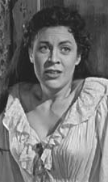
Justine and the Creature
The Creature’s first victim seems to be Victor Frankenstein’s brother—but people come to believe that the murder has been committed by Justine. Shelley, then, suggest that Justine and the Creature will share common characteristics.
Shelley hints at the complex ways that she will describe the Creature in her account of the servant Justine.
Shelley introduces Justine as a servant, while suggesting that servants tend to be treated terribly:
  “Justine, thus received in our family, learned the duties of a servant; a condition which, in our fortunate country, does not include the idea of ignorance, and a sacrifice of the dignity of a human being” (66).
But later, when Justine is accused, there are clearly some people who do think that Justine is both ignorant and lacks basic human dignity. To some degree, then, Justine is perceived, like Caliban was and the Creature will be, as less than human.

Slide 5
Justine and the Creature
Later, we will learn that Frankenstein’s creature reports that he was condemned by every village he encountered. The town at Justine’s trial similarly condemn her:
  A murmur of approbation followed Elizabeth's simple and powerful appeal, but it was excited by her generous interference, and not in favour of poor Justine, on whom the public indignation was turned with renewed violence, charging her with the blackest ingratitude. She herself wept as Elizabeth spoke, but she did not answer. My own agitation and anguish was extreme during the whole trial. I believed in her innocence; I knew it. Could the demon who had (I did not for a minute doubt) murdered my brother also in his hellish sport have betrayed the innocent to death and ignominy? I could not sustain the horror of my situation, and when I perceived that the popular voice and the countenances of the judges had already condemned my unhappy victim, I rushed out of the court in agony. The tortures of the accused did not equal mine; she was sustained by innocence, but the fangs of remorse tore my bosom and would not forgo their hold. (86)

Slide 6
Look at the description of Justine in Chapter VIII.
Where do you see Shelley hinting that Justine is being treated unfairly?
In the discussion topic Justine’s Treatment by the Crowd
Point out one place where Justine’s treatment seems to be unjust.
Respond to at least one other student's comment.

